Slide 1
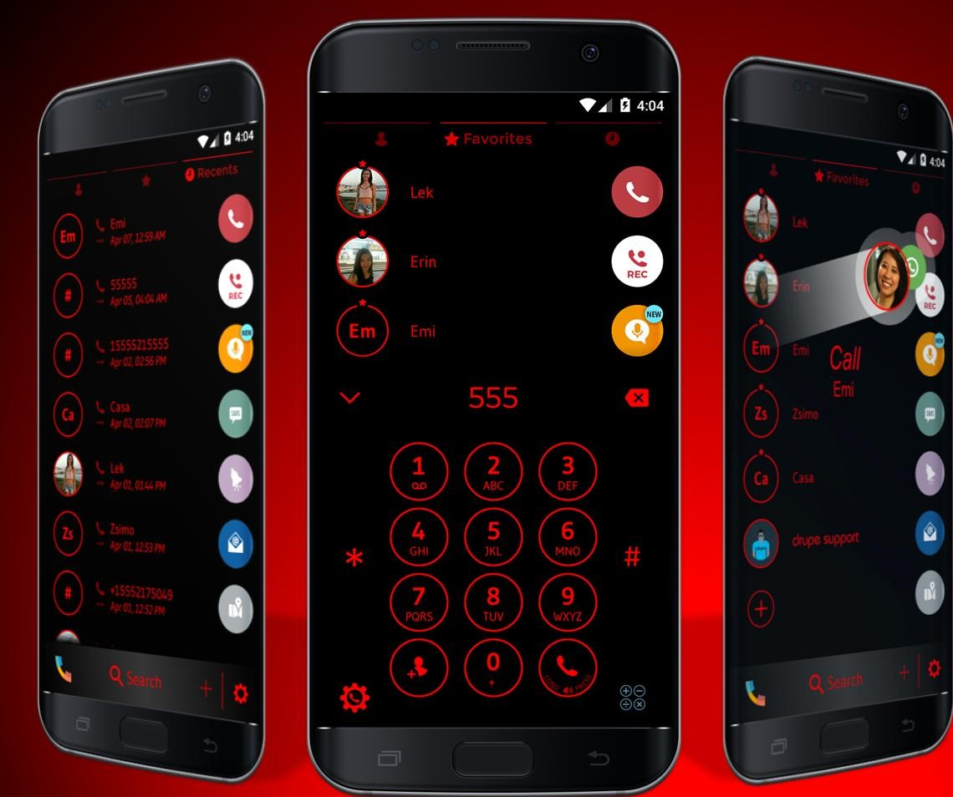
CONTACT MANAGEMENT
SYSTEM
Presentation of BIT-I Project
2020 Batch, CITE College
Prepared By:
Alok Poddar Baishya
Sujan Thapa
Raman Chaudhary
Anish Chaudhary

Slide 2
CONTENTS
Introduction
Problem Analysis
System Specification
Design & Methodology
Testing
Conclusion & Further Works
References

Slide 3
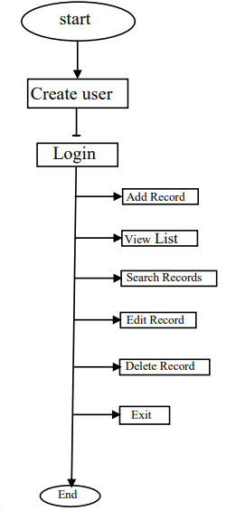
INTRODUCTION
Background
Proposed System
Objectives
Features

Slide 4
PROBLEM ANALYSIS
Problem Description
Saving Details
Security
Aim for the Project
Faster Performance
Many Features

Slide 5
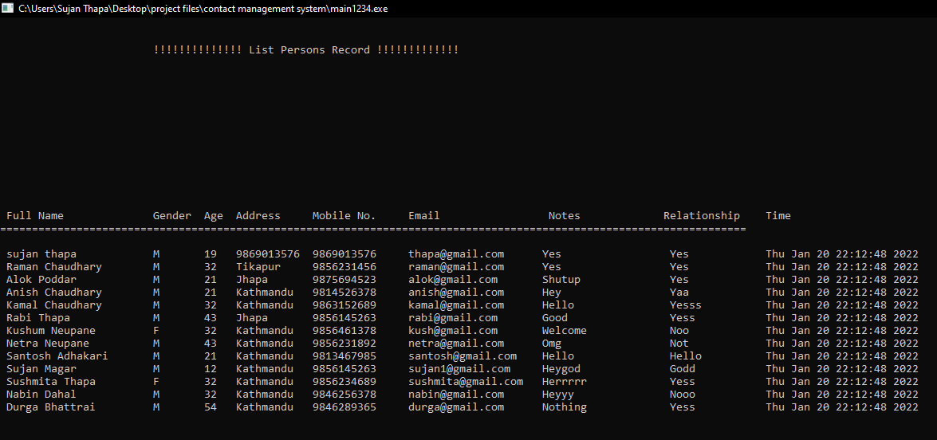

Slide 6
SYSTEM SPECIFICATION
Tools & Technologies
Software Developed At
Team Structure

Slide 7
DESIGN
& METHODOLOGY
System Interface:
Create User & Login
Main Menu:
(add contact, view saved record list, search contacts, edit record, delete record, exit)

Slide 8
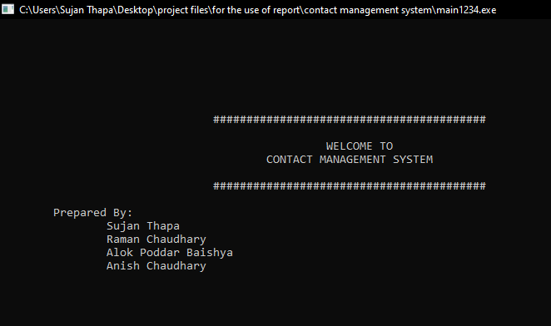
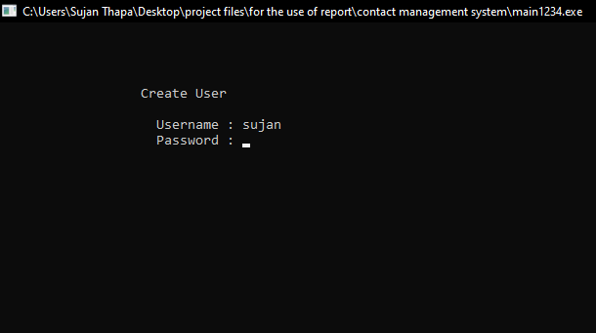
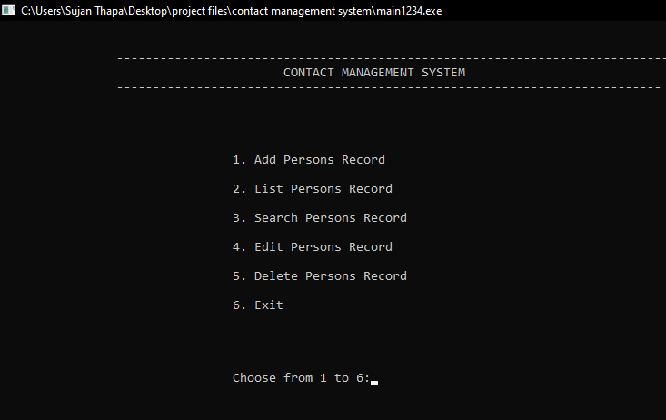
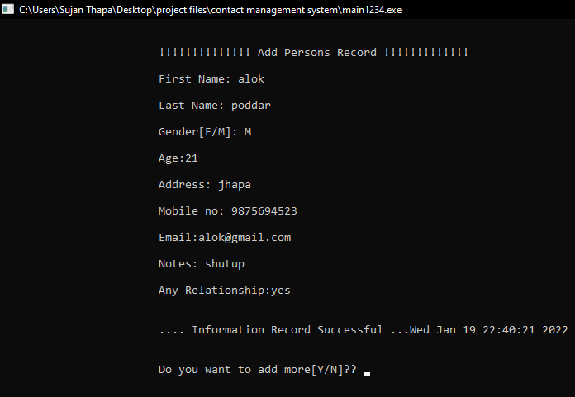

Slide 9
Algorithm
Flowchart
Implementation Plan
Implementation Details

Slide 10
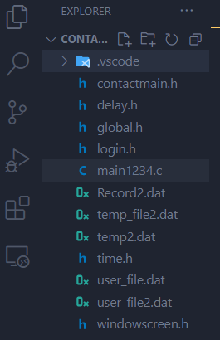
File Structure
File Handling
String

Slide 11
Pointers
DMA
Structures
Functions

Slide 12
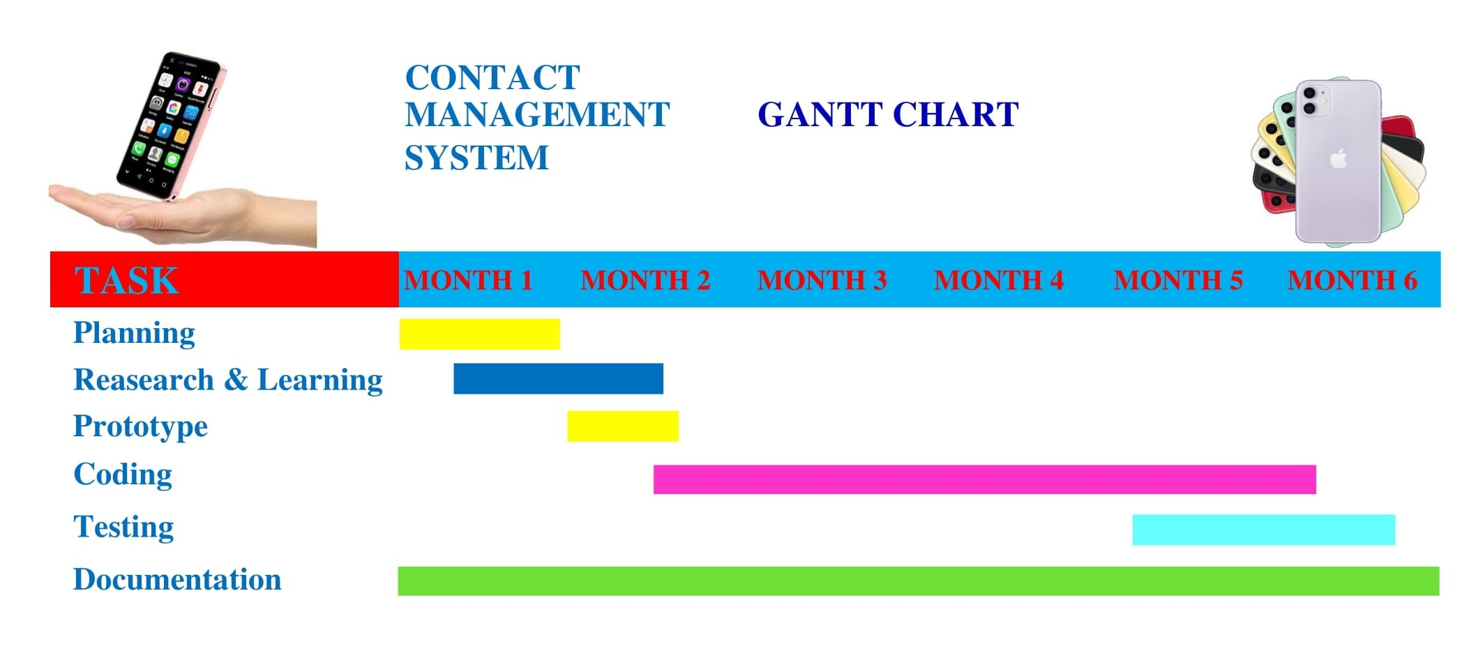
GANTT CHART

Slide 13
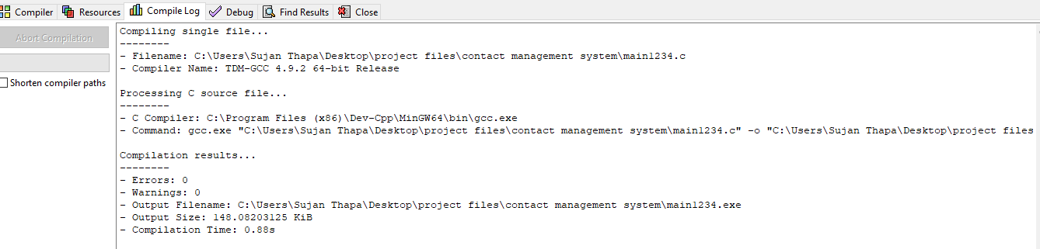
TESTING
Code Compilation & Run
Some Demo Screen Shots

Slide 14
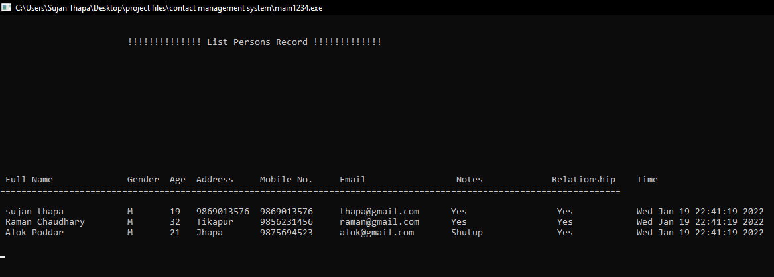
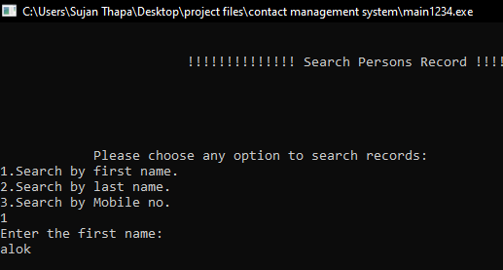
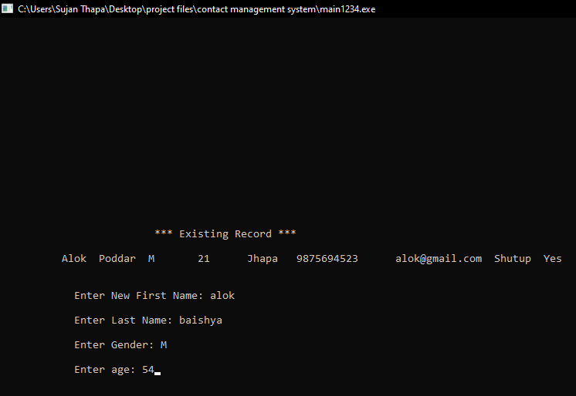

Slide 15
CONCLUSION & FURTHER WORKS
Conclusion
Scope in Business Fields
Learning From Project
Drawbacks
Further Works

Slide 16
REFERENCES
Google
https://www.codewithc.com/mini-project-in-c-contact-management-system/
Contact management system , phone book management system (slideshare.net)
GitHub
https://github.com/Thmid/Contact-Management-System
You Tube
https://www.youtube.com/watch?v=kmq3qS72kcg&ab_channel=GhemsTutor

